Slide 1
Topics
Interfaces in Java
Note : The Interface concepts in this Lecture Slide is Applicable for Java Versions Prior to Java8. The handling of interfaces in Java8 is somewhat different. Those Concepts shall be discussed separately.

Slide 2
Interfaces in Java [Prior to Java8]
Java does not support Multiple-Inheritance directly. Multiple inheritance can be achieved in java by the use of Interfaces.
We need interfaces when we want functionality to be included but does not want to impose implementation.
Implementation issue is left to the individual classes implementing the interfaces.
Interfaces can have only abstract methods and final fields.
Every method in an interface is by default public abstract
Every variable in an interface is by default public final
You can declare a variable to be of type interface. But you can not create an object belonging to type interface.
Interface variable can point to objects of any class implementing the interface.
Another way of implementing Run Time Polymorphism.

Slide 3
Class vs Interfaces (Similarities)
is compiled into byte code file
can be either public, protected, private or package accessibility
can not be public unless defined in the file having same name as interface name
serve as a type for declaring variables and parameters

Slide 4
Class vs Interfaces (Differences)
Declares only Method Headers and public constants
Has no constructors [So, an object never belongs to an interface].
Can be implemented by a class. A class can implement multiple interfaces.
Can not extend a class.
Can extend several other interfaces.

Slide 5
Interface Syntax : General Form
Syntax :
<scope> interface <interface-name> extends [ <interface1> ,… ,<interface-N>]
{
[public][final] <type> variable-name-1 = value;
.
.
[public][final] <type> variable-name-N = value;
[public][abstract] <return type> method-name-1(<parameter lis>);
.
.
[public][abstract] <return type> method-name-N(<parameter lis>);
}

Slide 6
Interface Example 1
public interface A
{
double PI = 3.14156;
void show();
void display();
} // End of Interface A
class X implements A
{
public void show() { }
public void display() { }
}// End of class X
Name of source file must be A.java
public final PI = 3.1456;
public abstract void show();
public abstract void display();
Implemented Methods of
Interfaces should have public scope

Slide 7
Interface Example 2
public interface A
{
double PI = 3.14156;
void show();
void display();
} // End of Interface A
abstract class X implements A
{
public void show() { }
}
class Y extends X
{
public void display() { }
}// End of class X
A class should either fully implement an interface or it should be declared as abstract

Slide 8
Interface Example 3
interface A
{
void show-1();
void display-1();
} // End of Interface A
interface B
{
void show-2();
void display-2();
} // End of Interface B
interface C extends A, B
{
void show-3();
void display-3();
} // End of Interface C
An interface can extend multiple interfaces
class X implements C
{
void show-1() { }
void display-1() { }
void show-2() { }
void display-2() { }
void show-3() { }
void display-3() { }
} // End of class X
If a class implements a sub-interface then it also implements its super interfaces

Slide 9
Interface Example 4
interface Area
{
double PI = 3.1456;
double area();
double perimeter();
} // End of Interface Area
interface Volume extends Area
{
double volume();
} // End of Interface Volume
<<Interface>>
Area
Volume
<<Interface>>

Slide 10
Interface Example 4 ….
class Circle implements Area
{
private double radius;
Circle(double radius)
{
this.radius = radius;
}
double getRadius() { return radius;}
public double area()
{
return PI * radius * radius;
}
public double perimeter()
{
return 2 * PI * radius;
}
}// End of class Circle

Slide 11
Interface Example 4 ….
class BOX implements Volume
{
private double length;
private double width;
private double height;
BOX(double l, double b, double h)
{
length = l;
width = b;
height = h;
}
double getLength() { return length ;}
double getWidth() { return width ;}
double getHeight() { return height ;}
public double volume()
{
return length * width * height ;
} // End of Method
public double perimeter()
{
double p = length+width+height;
return 4 * p;
}// End of Method
} // End of class BOX
public double area()
{
return 2 * (length * width + width * height + height * length);
} // End of Method

Slide 12
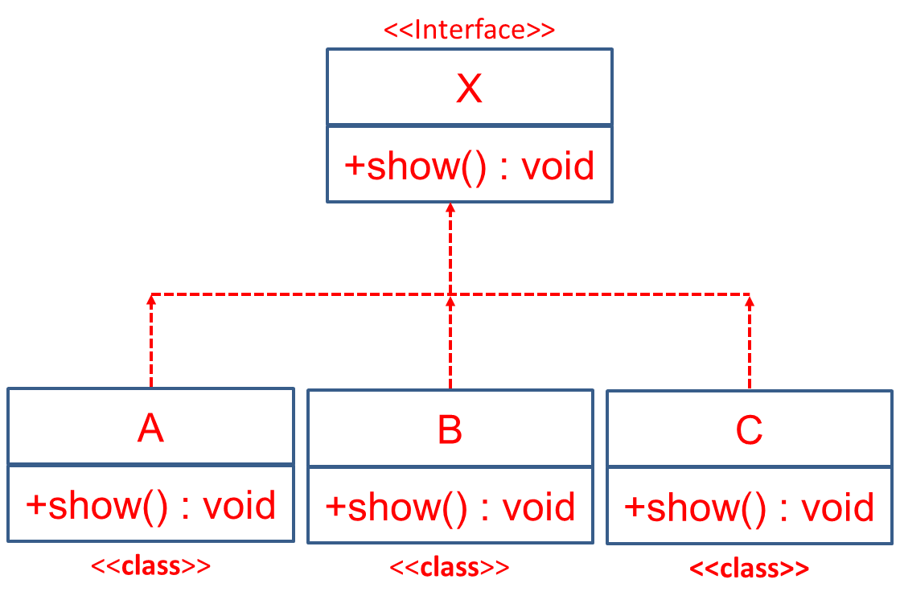
Runtime Polymorphism Through Interfaces
Suppose ‘X’ is an interface and three concrete classes namely ‘A’, ‘B’, and ‘C’ implements ‘X’ interface
Any Interface Type Variable Can Point to Any Instance of a Class That Implements the Interface
X x1 = new A();
x1.show();
x1 = new B();
x1.show();
Invokes show()
of class A
Invokes show()
of class B

Slide 13
Thank You

